Slide 1
SDI Presentation
By Collin R, Logan M, Matt G, and Noah B

Slide 2
Mission statement
UW Platteville wants to start online education in USA to attract the larger student population.
The system should be secured, efficient and scalable enough so that all the education-activities
(such as, quizzes, lectures, online grading, etc.) can be done accurately without any delay.

Slide 3
Customer Interview
Supported Users: 10,000
Create a subscription system with paid customers and free customers.
Add admin functions for adding and removing courses
Create Exams for receiving certificate
Mobile support is a plus
Notes:
Formatting Issue, Prioritize putting requirements from interview, Priorities in order of importance

Slide 4
Group Assignment
Requirement Analysis
Interviewing, Mission statement, Executive summary
4 employees 10 hours
Designing Project
Diagram creating
2 employees 7 hours
Selecting Infrastructure
Hardware, cloud, and network selection
2 employees 3 hours
Technology Survey
Database Survey, Web Technology Survey
2 employees 3 hours
Database Creation
Description, Setup, Hardware, Links, FAQ, Reviews, Debug
2 employees 5 hours
Business Logic Development
Retrive database, Store information
4 employees 2 hours
Website Development
Link to database, Make design, Basic Functions, Certificate functions, Final test and debug.
4 employees 5 hours
Testing
Unit and integration
4 employees, 5 hours
Notes:
Add descriptions to each bullet point, Change Hours for each assignment

Slide 5
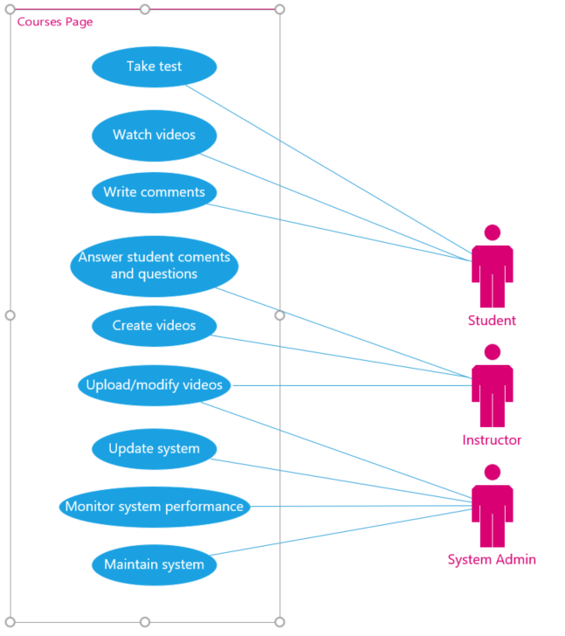
Use-Case Diagrams
Students can:
Take tests
Watch videos
Write comments
Instructors can:
Answer comments and questions
Create videos
Upload and Modify videos
System Administrators can:
Upload and Modify videos
Update the system
Monitor system performance
Maintain the system
Notes:
Add summary of diagram

Slide 6
Weekly Reports
2-02-2021- First meeting, Receiving the Project and Q/A
2-09-2021- Second meeting, Setting up the project file and allocating tasks
2-11-2021- Third meeting, Use case diagram
2-16-2021 Today’s meeting, Presentation on what the group has gathered so far

